Slide 1
AI – Prof. R.G.Mehta
Brief introduction to AI
Goal-based agents
Representing states and operators
Example problems
State-space search algorithm(Graph searching)

Slide 2
Introduction
General mechanism of searching and present it in terms of searching for paths in directed graphs.
First define the underlying search space
Apply a search algorithm to that search space.
A (directed) graph consists of a set of nodes and a set of directed arcs between nodes.
The core idea is to find a path along these arcs from a start node to a goal node.
there may be more than one way to represent a problem as a graph.
state-space searching as graph search
Nodes represent states
arcs represent actions

Slide 3
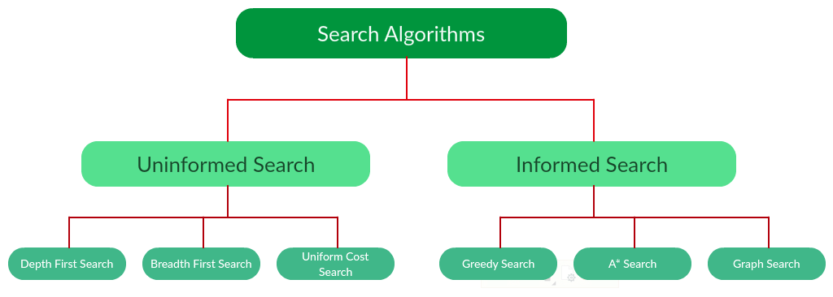
Brute Force Search
Heuristic Based Search

Slide 4
Brute force Techniques
Generate-And-Test
Breadth-First Search
Uniform-Cost Search
Depth-First Search
Depth-First Iterative-Deepening Search
Bidirectional Search

Slide 5
Depth-First Iterative Deepening (DFID) Search
DFID search combines the best features of BFS and DFS
To avoid the infinite depth problem of DFS, we can
decide to only search until depth L, i.e. we don’t expand beyond depth L.
→ Depth-Limited Search
What of solution is deeper than L? → Increase L iteratively.
→ Iterative Deepening Search
this inherits the memory advantage of Depth-First search
and
better in terms of time complexity than Breadth first search.
DFIDS first performs a DFS to depth one, then starts over, executing a complete DFS to depth two, and continues to run depth-first searches to successively greater depths, until a solution is found.
It never generates a node until all shallower nodes have been generated, the first solution found by DFIDS is guaranteed to be along a shortest path.
At any given point it is executing a DFS, saving only a stack of nodes, and the algorithm terminates when it finds a solution at depth d, the space complexity of DFIDS is only O(d).

Slide 6
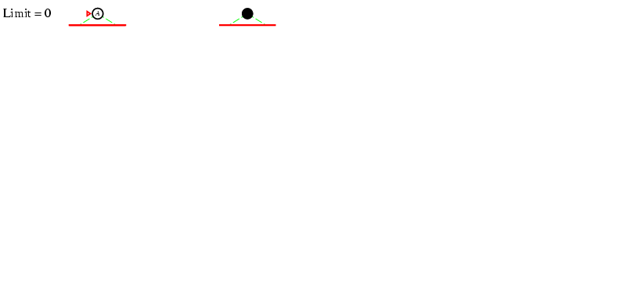
DFID search ( L=0 )

Slide 7
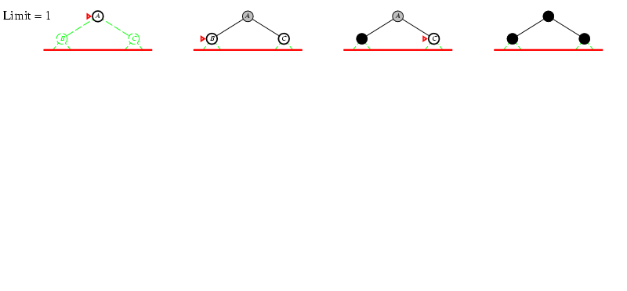
DFID Search (L=1)

Slide 8
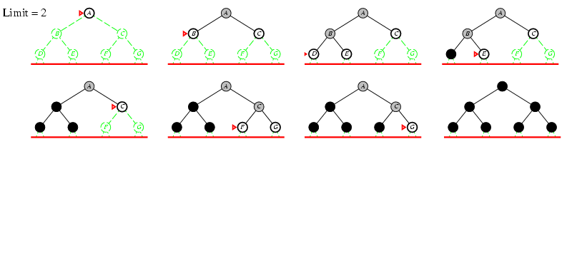
DFID Search (L=2)

Slide 9
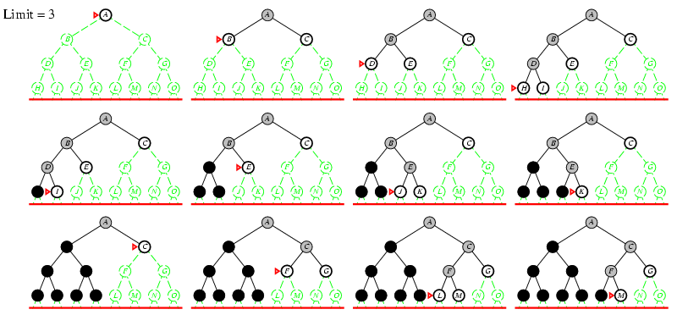
Iterative Deepening Search L=3

Slide 10
SELF THINKING:
Can you Combine DFID with UCS ?

Slide 11
Iterative deepening search (Self)
Number of nodes generated in a depth-limited search to depth d with branching factor b:
N_{DLS} = b⁰ + b¹ + b² + … + b^{d-2} + b^{d-1} + b^{d}
Number of nodes generated in an iterative deepening search to depth d with branching factor b:
N_{IDS} = (d+1)b⁰ + d b¹ + (d-1)b² + … + 3b^{d-2} +2b^{d-1} + 1b^{d} =
For b = 10, d = 5,
N_{DLS} = 1 + 10 + 100 + 1,000 + 10,000 + 100,000 = 111,111
N_{IDS} = 6 + 50 + 400 + 3,000 + 20,000 + 100,000 = 123,450
NBFS = ............................................................................................ = 1,111,100
BFS

Slide 12
Properties of iterative deepening search (Self)
Complete? Yes
Time? O(b^{d})
Space? O(bd)
Optimal? Yes, if step cost = 1 or increasing function of depth.

Slide 13
Example IDS

Slide 14
Depth-First Iterative Deepening Search
DFIDS wastes a great deal of time in the iterations prior to the one that finds a solution, this extra work is usually insiginificant.
Number of nodes at depth d is b^d, and each of these nodes are generated once, during the final iteration.
The number of nodes at depth d-1 is b^d-1, and each of these are generated twice, once during the final iteration, and once during the penultimate iteration (Pre last).
In general, the number of nodes generated by DFIDS is b^d + 2b^d-1 + 3b^d-2 +… + db.
This is asymptomatically O(b^d) if b is greater than one, since for larger values of d the lower order terms become insignificant.
Most of the work goes into the final iteration, and the cost of the previous iterations is relatively small.

Slide 15
Depth-First Iterative Deepening Search
The ratio of the number of nodes generated by DFID to those generated by BFS on a once is approximately b/(b-1).
In fact, depth first iterative deepening is asymptomatically optimal in terms of time and space among all brute-force shortest path algorithms on a tree.
If the edge costs differ from one another then one can run an iterative deepening version of uniform-cost search,
The depth cutoff is replaced by a cutoff on the g(n) cost of a node.
At the end of each iteration, the threshold for the next iteration is set to the minimum cost of all nodes generated on the previous iteration whose cost exceeded the previous threshold.

Slide 16
Some comments on DFS and BFS
In a graph with cycles, however, BFS may be much more efficient than any DFS.
As a BFS can check for duplicate nodes whereas a DFS cannot.
complexity of BFS grows only as the number of nodes at a given depth, while the complexity of DFS depends on the number of paths of a given length.
E.g. in a square grid, the number of nodes within a radious r of the origin is O(r^2), whereas the number of paths of length r is O(3^r), since there are three children of every node, counting its parent.
Thus, in a graph with a large number of very short cycles, breadth-first search is preferable to depth-first search, if sufficient memory is available.

Slide 17
Brute force Techniques
Generate-And-Test
Breadth-First Search
Uniform-Cost Search
Depth-First Search
Depth-First Iterative-Deepening Search
Bidirectional Search

Slide 18
Bidirectional Search
Searches in two directions at the same time:
one forward from the initial state
Other backward from the goal
Idea
simultaneously search forward from S and backwards from G
stop when both “meet in the middle”
need to keep track of the intersection of 2 open sets of nodes
requires an explicit goal state instead of simply a test for a goal condition
Once the search is over, the path from the initial state is then concatenated with the inverse of the path from the goal state to form the complete solution path.

Slide 19
Bidirectional Search
Bidirectional Search
What does searching backwards from G mean
need a way to specify the predecessors of G
this can be difficult,
e.g., predecessors of checkmate in chess?
which to take if there are multiple goal states?
where to start if there is only a goal test, no explicit list?

Slide 20
Bidirectional Search (Cont..)
It guarantees optimal solutions.
Assuring that the comparisons for identifying a common state between the two frontiers can be done in constant time per node by hashing.
The time complexity of Bidirectional Search is O(b^d/2) since each search need only proceed to half the solution path.
Since at least one of the searches must be breadth-first in order to find a common state, the space complexity of bidirectional search is also O(b^d/2).
As a result, it is space bound in practice.

Slide 21
Pros and Cons of Bidirectional Search
Advantages
The merit of bidirectional search is its speed. Sum of the time taken by two searches (forward and backward) is much less than the O(b^{d}) complexity.
It requires less memory.
Disadvantages
Implementation of bidirectional search algorithm is difficult because additional logic must be included to decide which search tree to extend at each step.
One should have known the goal state in advance.
The algorithm must be too efficient to find the intersection of the two search trees.
It is not always possible to search backward through possible states.

Slide 22
Combinatorial Explosion
The problem with all brute-force search algorithms is that their time complexities grow exponentially with problem size.
This problem is called combinatorial explosion.
The combinatorial explosion results in limited size of problems that can be solved with brute-force search techniques.
E.g. while eight-puzzle with 10⁵ states is easily solved by brute-force search,
The fifteen-puzzle contains over 10¹³ states, and hence cannot be solved with brute-force techniques on current machines.
Even faster machines cannot have significant impact on this problem since the 5 * 5 twenty-four puzzle contains almost 10²⁵ states.

Slide 23
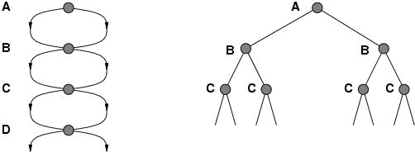
Repeated states
Failure to detect repeated states can turn a linear problem into an exponential one!

Slide 24
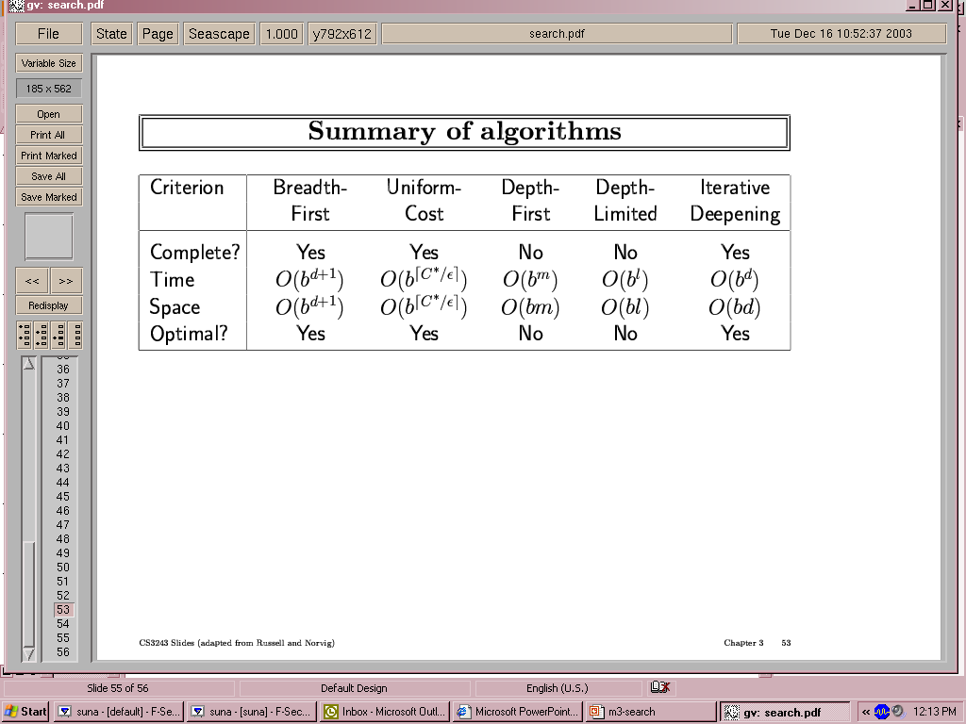
Summary of algorithms
even complete
if step cost is not
increasing with depth.
preferred
uninformed
search strategy

Slide 25
Summary
Problem formulation usually requires abstracting away real-world details to define a state space that can feasibly be explored
Variety of uninformed search strategies
Iterative deepening search uses only linear space and not much more time than other uninformed algorithms
Other than text book :
https://www.geeksforgeeks.org/search-algorithms-in-ai/
http://www.cs.rmit.edu.au/AI-Search/Product/
http://aima.cs.berkeley.edu/demos.html (for more demos)

Slide 26
Different approaches
Brute-Force Approach
Heuristic Search
Two-Player-Games Search
Interleaving Search

